Slide 1
WELCOME!
May 5th
Sixth Sunday
of Easter
& Communion Sunday

Slide 2
Prelude and
Ringing of the Church Bell

Slide 3
Announcements
Printed Announcements
are in your bulletins.

Slide 4
Today’s Speaker:
Reverend Robert Wecht,
Retired Elder

Slide 5
Mother’s Day is May 12th
Mother’s Day Honor Roll Forms
are in the Narthex. Please submit them today!
Honor or Remember your
Mother, Grandmother, Sister, Aunt!

Slide 6
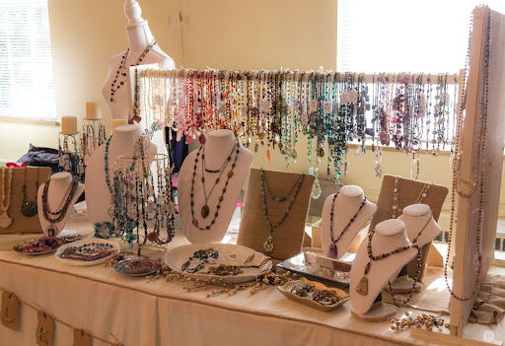
SOUP LUNCH & JEWELRY BOUTIQUE
Monday, May 6th 11:30AM-12:30PM
Please join us for Shopping, Home Made Soups, Bread, Crackers,
Dessert & Beverage. Free Will Offering

Slide 7
Liturgists are Needed for future months.
Please sign up!
Sign-Up sheet is in the
Fellowship Hall.
Thank you!

Slide 8
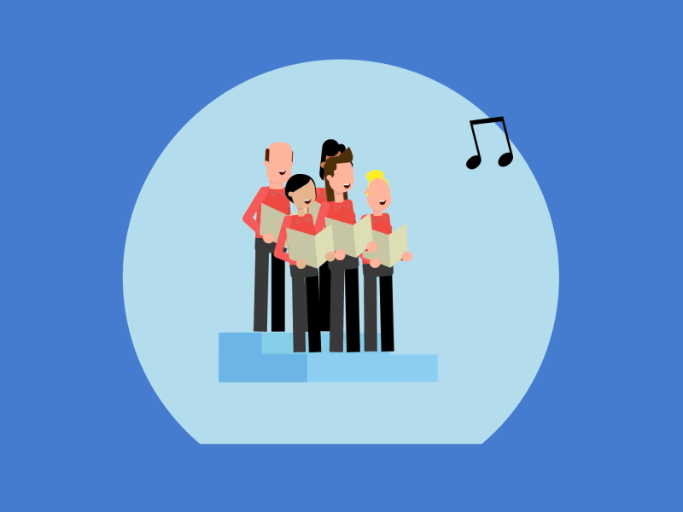
Choir Practice is on Friday at 1:00PM
If you are interested in singing in the choir,
please talk to Bill or any Choir Member!

Slide 9
Looking ahead…
INDOOR YARD SALE
SATURDAY, JUNE 22ND
9AM-2PM
Currently collecting donations
YARD

Slide 10
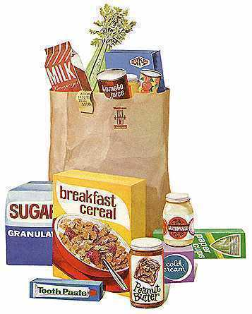
FOOD PANTRY IS
ALWAYS IN NEED OF DONATIONS.
Food Pantry is open
Tues. & Thurs.
from 10-Noon
March served 120 Families,
269 adults, 120 children, (389 total)

Slide 11
BIRTHDAY BANK
Happy Birthday
To You!
May God richly Bless You!

Slide 12
*CALL TO WORSHIP
Led by Adri Lieb
*Please stand.

Slide 13
L: Beloved, we are called to love one another, because love is from God.
P: God’s love is poured in us from our birth.

Slide 14
L: We are called to extend the love of God
to all people.
P: God’s loved is taught to us through the witness of God’s faithful people.

Slide 15
L: We are called to proclaim God’s love
in all that we say and do.
All: In all creation, in all our relationships, may God’s love be made known. Amen.

Slide 16
*HYMN OF PRAISE:
“Come, Christians, Join to Sing”
UMH #158
*Please Stand

Slide 17
Come, Christians, join to sing:
Alleluia! Amen!
loud praise to Christ our King:
Alleluia! Amen!
Let all, with heart and voice,
before his throne rejoice;
praise is his gracious choice.
Alleluia! Amen!

Slide 18
Come, lift your hearts on high:
Alleluia! Amen!
Let praises fill the sky:
Alleluia! Amen!
He is our guide and friend;
to us he’ll condescend;
his love shall never end:
Alleluia! Amen!

Slide 19
Praise yet the Lord again:
Alleluia! Amen!
Life shall not end the strain:
Alleluia! Amen!
On heaven’s blissful shore
his goodness we’ll adore,
singing forevermore:
Alleluia! Amen!

Slide 20
Pass the Peace

Slide 21
*AFFIRMATION OF FAITH
(In Unison)
A STATEMENT OF FAITH
OF THE UNITED CHURCH OF CANADA
UMH #883
Led by Adri Lieb
*Please Stand

Slide 22
We are not alone,
we live in God's world.
We believe in God:
who has created and is creating,
who has come in Jesus,
the Word made flesh,
to reconcile and make new,
who works in us and others
by the Spirit.
We trust in God.

Slide 23
We are called to be the church:
to celebrate God's presence,
to love and serve others,
to seek justice and resist evil,
to proclaim Jesus,
crucified and risen,
our judge and our hope.

Slide 24
In life,
in death,
in life beyond death,
God is with us.
We are not alone.
Thanks be to God.
Amen.

Slide 25
PLEASE
BE SEATED

Slide 26
Anthem ~ Chancel Choir

Slide 27
OFFERING INVITATION

Slide 28
*DOXOLOGY
*Please stand if able.
Praise God, from whom all blessings flow; praise him, all creatures here below; praise him above, ye heavenly host; praise Father, Son, and Holy Ghost. Amen.

Slide 29
PLEASE
BE SEATED

Slide 30
OFFERTORY PRAYER
(In Unison)
Led by
Reverend
Robert Wecht

Slide 31
All:
Dear God,
how difficult it must have been for the disciples, having again spent time with the Risen Christ, to be confronted with his upcoming return to God.
They wanted to keep him near them forever, but he was called back home to his Father.

Slide 32
All:
He understood their fears and their concerns and offered to them a sense of what they must do.
They must truly love each other as God has truly loved each one of them.
Can we do any less?

Slide 33
All:
We are called to love each one here,
with the kind of love that Christ displayed, patient, respectful, strong.
Our world would have us believe
that love is that emotion which is manipulative;
we love in order to get what we want.

Slide 34
All:
How sad it is!
We are called to a higher understanding. Love must take the form of service and compassion, of hope and proclamation,
of patient waiting and urgent striving for the good of all people.

Slide 35
All:
Open our hearts today, Lord,
and imprint your message of love upon them, that all we say and do is done in your name and for the sake of your people and your world.
Amen.

Slide 36
JOYS & CONCERNS

Slide 37
PASTORAL PRAYER

Slide 38
*HYMN:
“God of the Sparrow God of the Whale” UMH #122
Please Stand
Words: Jaroslav J. Vajda, 1983 Music: Carl F. Schalk

Slide 39
God of the sparrow
God of the whale
God of the whirling stars
How does the creature say Awe
How does the creature say Praise

Slide 40
God of the earthquake
God of the storm
God of the trumpet blast
How does the creature cry Woe
How does the creature cry Save

Slide 41
God of the rainbow
God of the cross
God of the empty grave
How does the creature say Grace
How does the creature say Thanks

Slide 42
God of the hungry
God of the sick
God of the prodigal
How does the creature say Care
How does the creature say Life

Slide 43
God of the neighbor
God of the foe
God of the pruning hook
How does the creature say Love
How does the creature say Peace

Slide 44
God of the ages
God near at hand
God of the loving heart
How do your children say Joy
How do your children say Home

Slide 45
SCRIPTURE READING:
John 15:9-17 NIV
Read by Adri Lieb

Slide 46
⁹ “As the Father has loved me, so have I loved you. Now remain in my love. ¹⁰ If you keep my commands, you will remain in my love, just as I have kept my Father’s commands and remain in his love. ¹¹ I have told you this so that my joy may be in you and that your joy may be complete.

Slide 47
¹² My command is this: Love each other as I have loved you. ¹³ Greater love has no one than this: to lay down one’s life for one’s friends.
¹⁴ You are my friends if you do what I command. ¹⁵ I no longer call you servants, because a servant does not know his master’s business. Instead, I have called you friends, for everything that I learned from my Father I have made known to you.

Slide 48
¹⁶ You did not choose me, but I chose you and appointed you so that you might go and bear fruit—fruit that will last—and so that whatever you ask in my name the Father will give you.
¹⁷ This is my command: Love each other.

Slide 49
SERMON:
- Reverend Robert Wecht

Slide 50
The Prayer of Great Thanksgiving

Slide 51
The Lord be with you.
And also with you.
Lift up your hearts.
We lift them up to the Lord.
Let us give thanks to the Lord our God.
It is right to give our thanks and praise.

Slide 52
It is right, and a good and joyful thing,
always and everywhere
to give thanks to you,
Almighty God, creator of heaven and earth.
You formed us in your image
and breathed into us the breath of life.
When we turned away, and our love failed,
your love remained steadfast.

Slide 53
You delivered us from captivity,
made covenant to be our sovereign God,
and spoke to us through your prophets.
And so, with your people on earth,
and all the company of heaven,
we praise your name
and join their unending hymn:

Slide 54
Holy, holy, holy Lord,
God of power and might,
Heaven and earth are full of your glory.
Hosanna in the highest.
Blessed is the one
who comes in the name of the Lord.
Hosanna in the highest.

Slide 55
Holy are you, and blessed is your Son Jesus Christ.
Your Spirit anointed him
to preach good news to the poor,
to proclaim release to the captives
and recovering of sight to the blind,
to set at liberty those who were oppressed,
and to announce that the time would come
when you would save your people.

Slide 56
He healed the sick,
fed the hungry, and ate with sinners.
By the baptism of his suffering,
death and resurrection
you gave birth to your church,
delivered us from slavery to sin and death,
and made with us a new covenant
by water and the Spirit.

Slide 57
When the Lord Jesus ascended,
he promised to be with us always,
in the power of your Word and Holy Spirit.
On the night in which he gave himself up for us,
he took bread, gave thanks to you, broke the bread,
gave it to his disciples, and said:
“Take, eat; this is my body which is given for you.
Do this in remembrance of me.”

Slide 58
When the supper was over, he took the cup,
gave thanks to you, gave it to his disciples, and said:
“Drink from this, all of you;
this is my blood of the new covenant,
poured out for you and for many
for the forgiveness of sins.
Do this, as often as you drink it,
in remembrance of me.”

Slide 59
And so, in remembrance
of these your mighty acts in Jesus Christ,
we offer ourselves in praise and thanksgiving
as a holy and living sacrifice,
in union for Christ’s offering for us,
As we proclaim the mystery of faith.
Christ has died.
Christ is risen.
Christ will come again.

Slide 60
Pour out your Holy Spirit on us gathered here,
and on these gifts of bread and wine.
Make them be for us the body and blood of Christ,
that we may be for the world the body of Christ,
redeemed by his blood.
By your Spirit make us one with Christ,
one with each other,
and one in ministry to all the world,

Slide 61
until Christ comes in final victory
and we feast at his heavenly banquet.
Through your Son Jesus Christ,
with the Holy Spirit in your holy church,
all honor and glory is yours, Almighty God,
now and forever. Amen.

Slide 62
The Lord’s Prayer
Our Father who art in heaven, hallowed be thy name, thy kingdom come, thy will be done, on earth as it is in heaven. Give us this day our daily bread. And forgive us our trespasses as we forgive those who trespass against us. And lead us not into temptation
but deliver us from evil. For thine is the kingdom,
and the power, and the glory forever. Amen.

Slide 63
Breaking of the Bread
Because there is one loaf, we, who are many, are one body,
for we all share in the one loaf. The bread which we break
is a sharing in the body of Christ.
The cup over which we give thanks
is a sharing in the blood of Christ.

Slide 64
SHARING THE BREAD AND CUP
The body of Christ, given for you. Amen. The blood of Christ, given for you. Amen.
Eternal God, we give you thanks for this holy mystery in which you have given yourself to us. Grant that we may go into the world in the strength of your Spirit, to give ourselves for others, in the name of Jesus Christ our Lord. Amen.

Slide 65
SENDING FORTH
Go forth in peace. The grace of the Lord Jesus Christ,
and the love of God, and the communion of the Holy Spirit be with you all. Amen.

Slide 67
*CLOSING HYMN:
“Victory in Jesus”
UMH #370
*Please Stand

Slide 68
I heard an old, old story,
How a Savior came from glory,
How He gave His life on Calvary
To save a wretch like me;
I heard about His groaning,
Of His precious blood’s atoning,
Then I repented of my sins
And won the victory.

Slide 69
O victory in Jesus,
My Savior forever!
He sought me
And bought me
With His redeeming blood;
He loved me
Ere I knew Him,
And all my love is due Him;
He plunged me to victory
Beneath the cleansing flood.

Slide 70
I hear about His healing,
Of His cleansing power revealing,
How He made the lame to walk again
And caused the blind to see;
And then I cried, “Dear Jesus,
Come and heal my broken spirit,”
And somehow Jesus came and brought
To me the victory.

Slide 71
O victory in Jesus,
My Savior forever!
He sought me
And bought me
With His redeeming blood;
He loved me
Ere I knew Him,
And all my love is due Him;
He plunged me to victory
Beneath the cleansing flood.

Slide 72
I heard about a mansion
He has built for me in glory,
And I heard about
The streets of gold
Beyond the crystal sea;
About the angels singing
And the old redemption story,
And some sweet day
I’ll sing up there
The song of victory.

Slide 73
O victory in Jesus,
My Savior forever!
He sought me
And bought me
With His redeeming blood;
He loved me
Ere I knew Him,
And all my love is due Him;
He plunged me to victory
Beneath the cleansing flood.

Slide 74
*BENEDICTION WITH BLESSING
Rev. Robert Wecht

Slide 75
Friends and Beloved of Christ,
you have been chosen to go into this world with the message of God’s love.
Bear fruit of hope and joy,
peace and justice,
with all that you meet.
May God’s peace be with you all. AMEN.

Slide 76
Shalom to you now, shalom, my friends.
May God’s full mercies bless you, my friends.
In all your living, and through your loving,
Christ be your shalom,
Christ be your shalom.

